Slide 1
Generative art
Workshop

Slide 2
Overview
Insight & inspiration
Practice time
How does this work
Theory
Write code to generate a pattern step by step
Free assisted practice time
Notes:
https://pbs.twimg.com/media/C2591pKUkAAnerH.jpg

Slide 3
What is generative art?
Anything that can be produced by rules, formulas and algorithms
Some keywords
Procedural generation
Fractals
Plotter art
Cellular automata
Particle systems/agents
Tessellation
Sacred geometry
Kaleidoscope/mandala’s

Slide 4
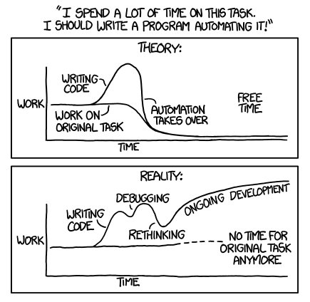
Why
To make cool looking art
To automate boring manual repetitive work
Coding is just like any other tool that you can use to create things.
Notes:
https://pbs.twimg.com/media/C2591pKUkAAnerH.jpg

Slide 5
Examples

Slide 6
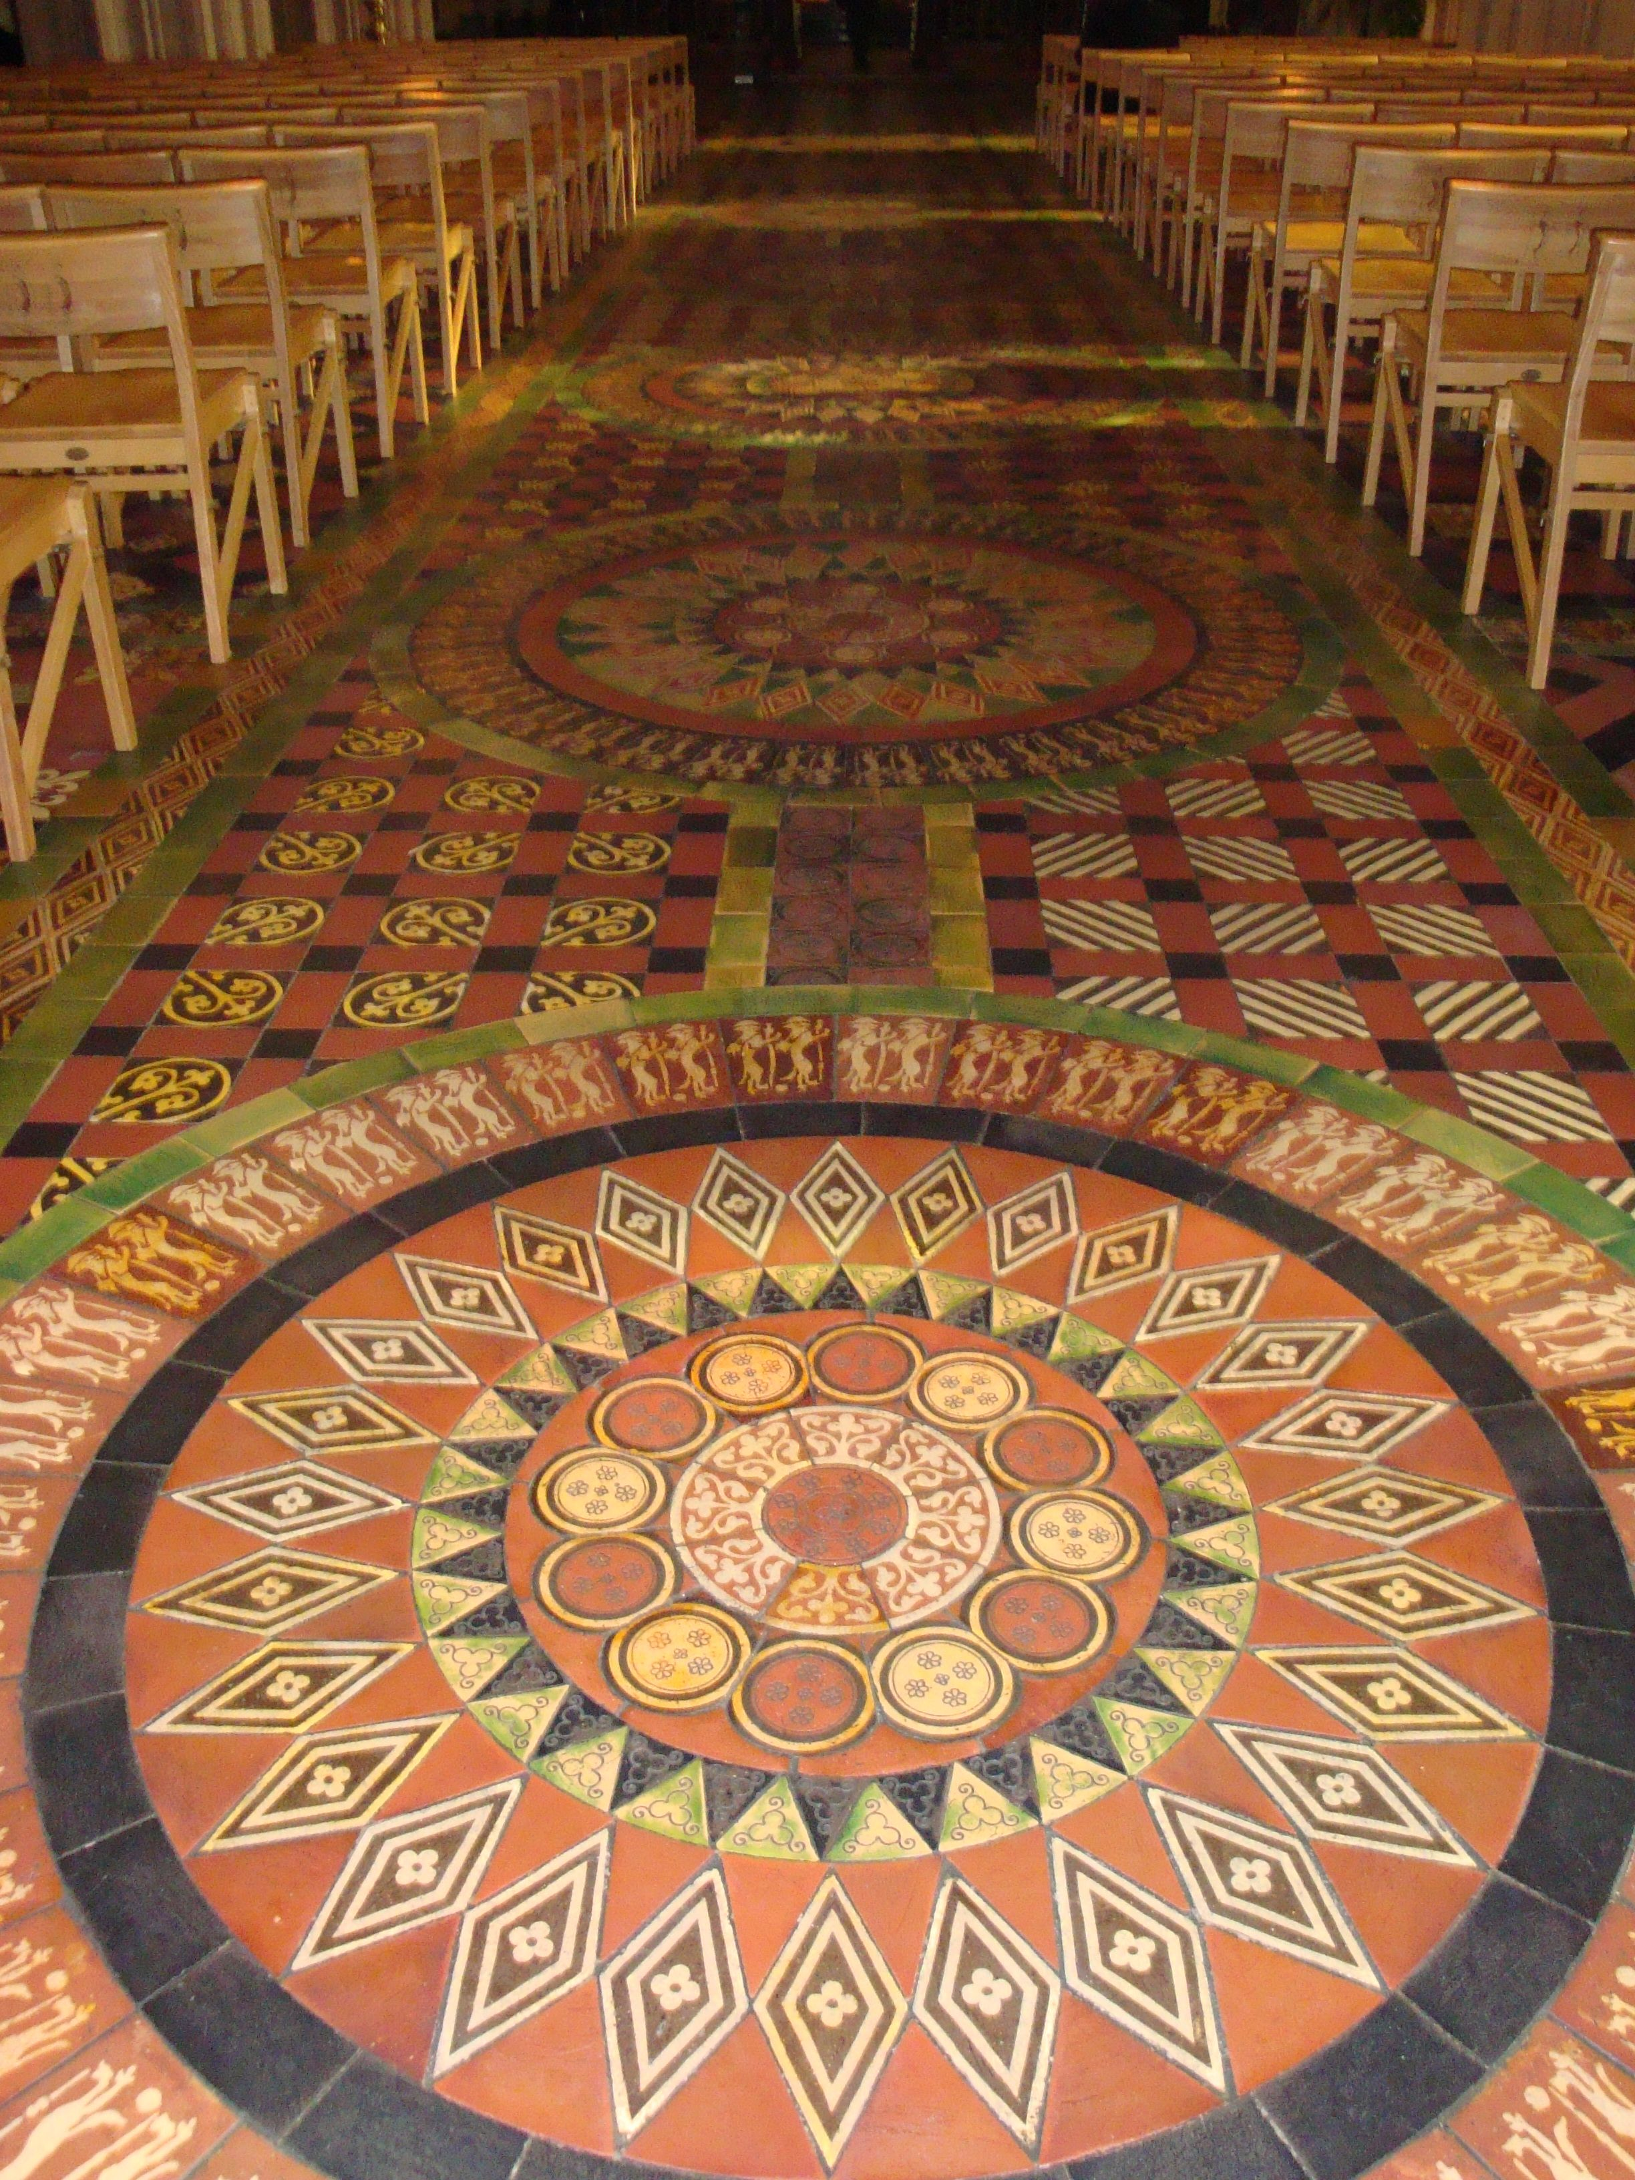
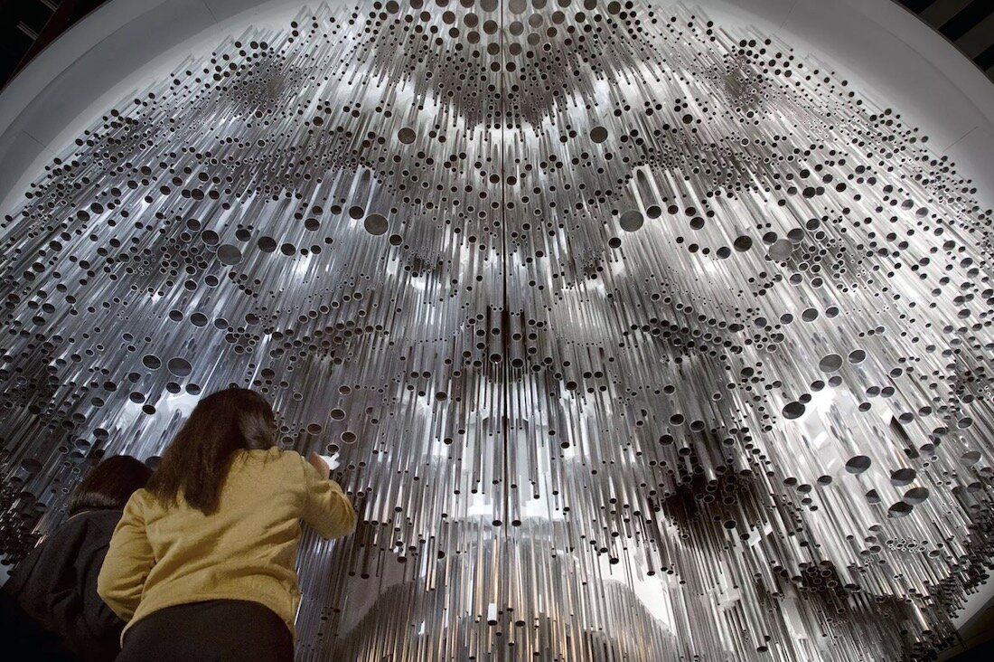
Examples in architecture
Mori art exhibition
Islamic art on mosque minaret
Church floor
Notes:
https://upload.wikimedia.org/wikipedia/commons/6/6d/Samarkand_Bibi_Khanum_Mosque_Minaret_Detail.JPG
https://i.pinimg.com/originals/8f/c1/4e/8fc14e0c87a0cee269958e5f9af9155d.jpg
https://images.squarespace-cdn.com/content/v1/5c77350965a707ed1710a1bc/1592325629144-K59AOID0SQXL83JYPZPK/ke17ZwdGBToddI8pDm48kGZLPwpiCEAiBJ-A_pyX5LAUqsxRUqqbr1mOJYKfIPR7LoDQ9mXPOjoJoqy81S2I8N_N4V1vUb5AoIIIbLZhVYxCRW4BPu10St3TBAUQYVKcktB1ki3bnWHx57is2Sg4AbNycoZ-O01wIGAMohM3QPAFFY2EeMR6nY3njbUx2sJa/Generative+Architecture+by+Michael+Hansmeyer.jpg

Slide 7
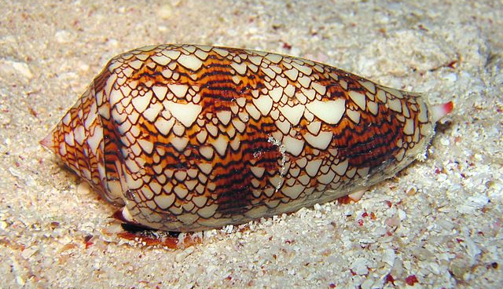
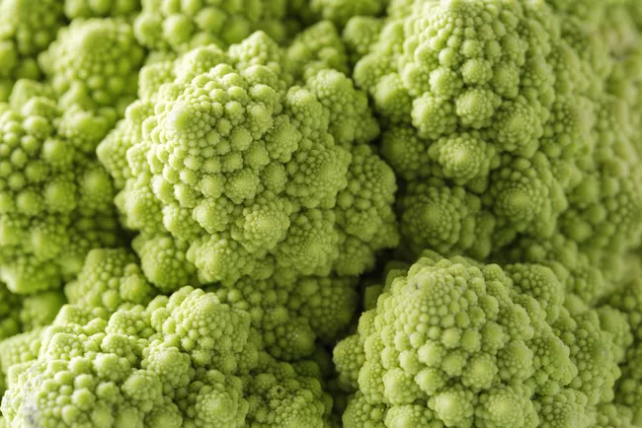
Examples in nature
Reaction diffusion texture in various animals
Voronoi in a dragonfly wing
Fractals in broccoli
Cellular automata (rule 30) on a shell
Notes:
https://blogs.scientificamerican.com/observations/voronoi-tessellations-and-scutoids-are-everywhere/
https://plus.maths.org/content/cellular-automata
https://n-e-r-v-o-u-s.com/projects/i.php?/000/765/reaction-1,medium_large.1416003956.jpg
https://www.treehugger.com/amazing-fractals-found-in-nature-4868776

Slide 8
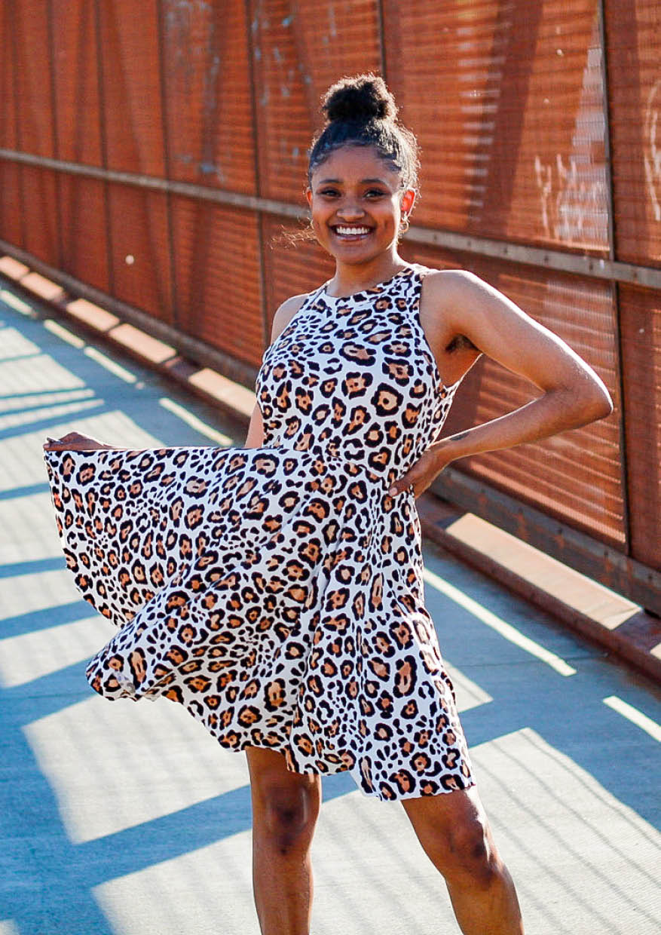
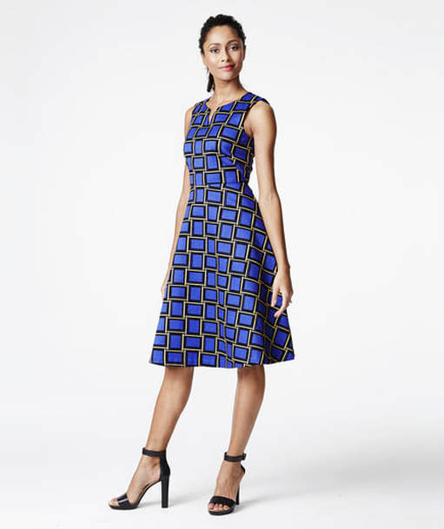
Examples in clothing
Polkadot dress: uniform placement of circles
Non uniform pattern, certain degree of "randomness"
Notes:
https://i.pinimg.com/originals/70/41/98/704198a01d93b08fd899ae875bb12e33.jpg
https://cdn.shopify.com/s/files/1/1108/7416/products/Tank-Dress-Sewing-Pattern-Emporium-COVER_877x.jpg?v=1652311788
https://www.dopicoart.com/uploads/1/0/1/0/101044820/published/thelimited-squares-dress.jpg?1510930036

Slide 9
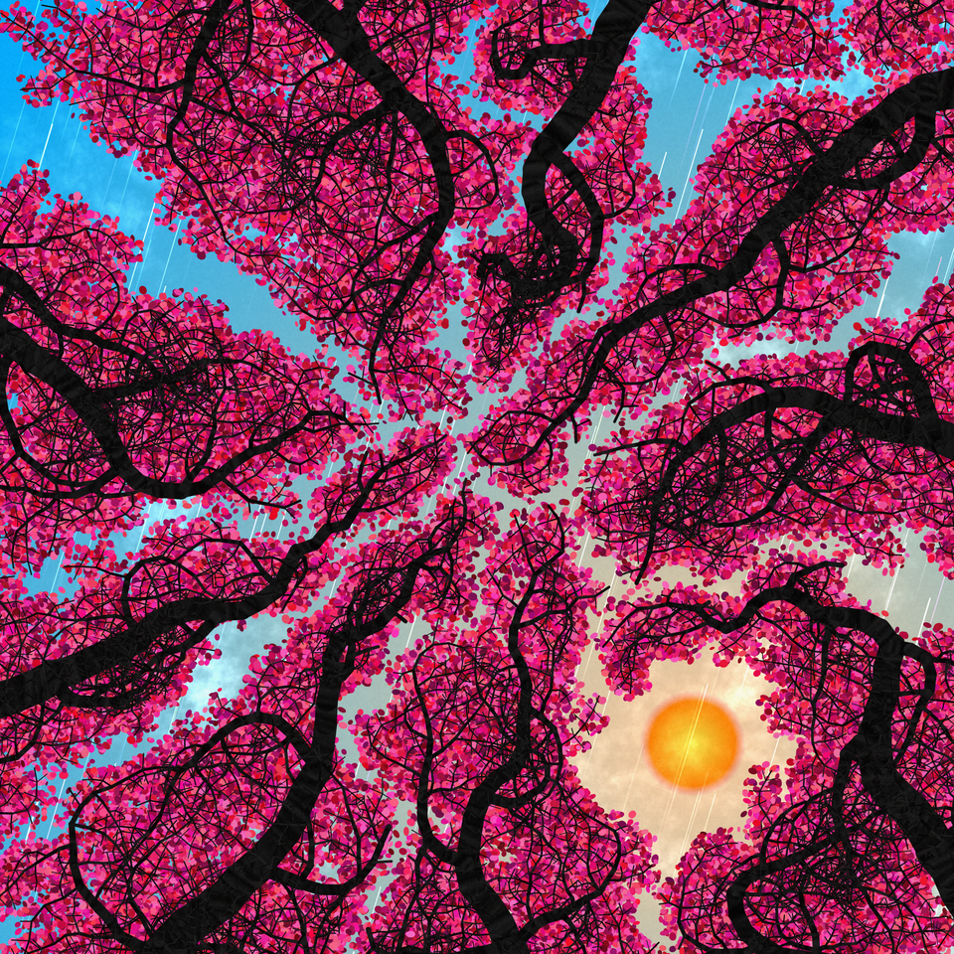
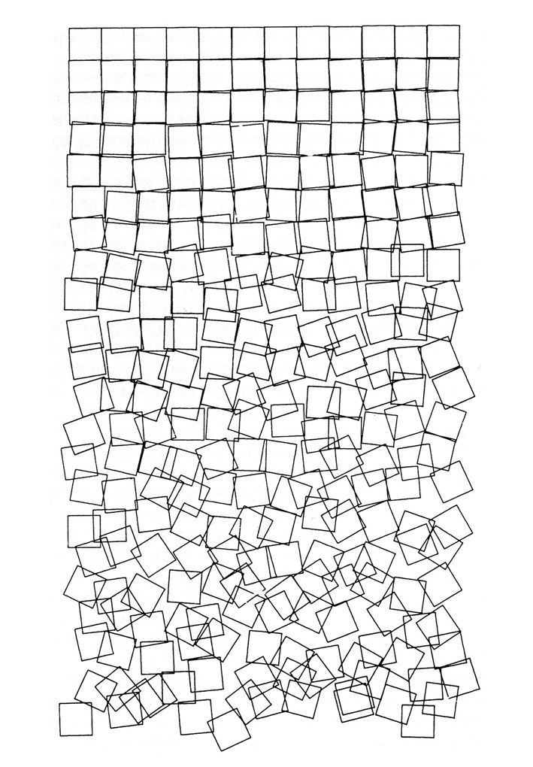
Or just art
Notes:
https://tylerxhobbs.com/essays/2018/executing-generative-art-with-a-plotter
https://tylerxhobbs.com/essays/2021/the-importance-of-generative-art
https://tylerxhobbs.com/essays/2021/color-arrangement-in-generative-art
https://www.artnome.com/news/2018/8/8/why-love-generative-art
https://www.reddit.com/r/generative/comments/t30dkp/crown_shyness_simulation/

Slide 10
And more
Mandelbrot fractal
Flower of life
(Sacred geometry/mandala)
Kaleidoscope
(rotational symmetry)
Notes:
https://images.squarespace-cdn.com/content/v1/5c77350965a707ed1710a1bc/1592332038533-A6ENQC77CII45S8I765Y/Mandelbrot+Set.jpg
https://medium.com/@brokyo/drawing-the-flower-of-life-22206fe36d02
https://static.vecteezy.com/system/resources/previews/000/198/819/original/vector-kaleidoscope-pattern.jpg

Slide 11
Communities
Generative art: https://www.reddit.com/r/generative/top/?t=all
Procedural generation: https://www.reddit.com/r/proceduralgeneration/top/?t=all
Fractal art: https://www.reddit.com/r/FractalPorn/top/?t=all
Plotter art: https://www.reddit.com/r/PlotterArt/top/?t=all

Slide 12
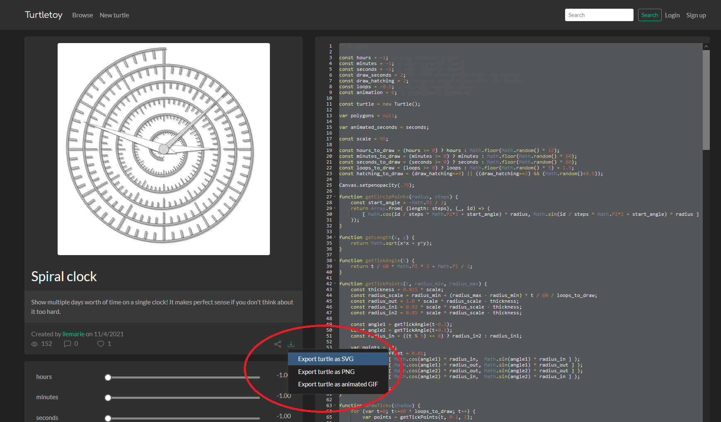
Communities: turtletoy
Black and white plotter art: https://turtletoy.net/

Slide 13
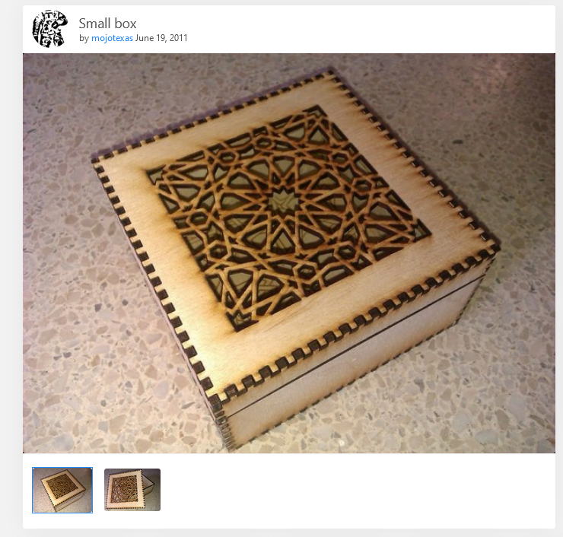
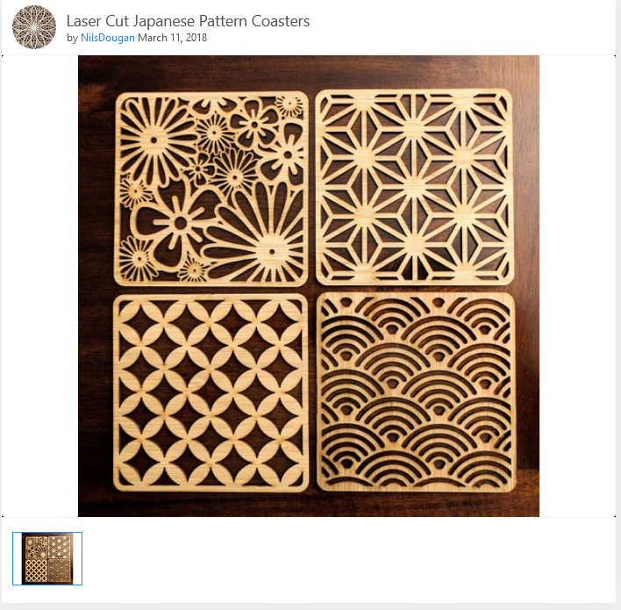
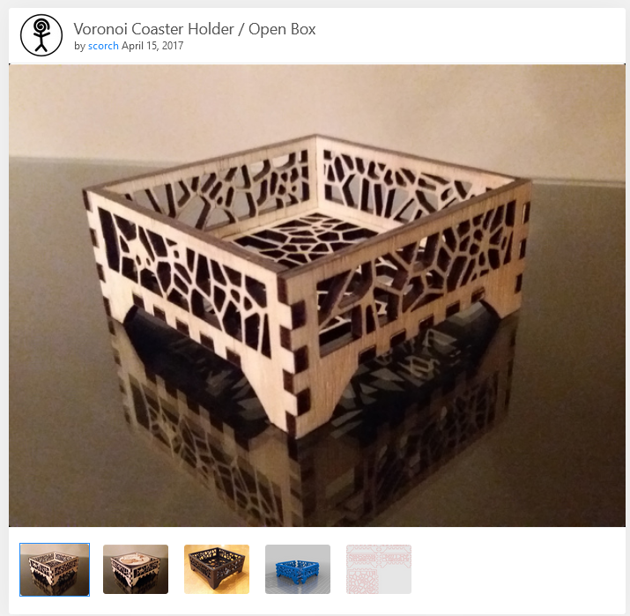
Combine with laser cutting
Notes:
https://www.thingiverse.com/thing:9452
https://www.thingiverse.com/thing:2271572
https://www.thingiverse.com/thing:2821011
https://www.thingiverse.com/thing:2250238

Slide 14
Practice time!
Get familiar with the development environment
Learn how to comment / uncomment code to execute the patterns
Learn to play with the patterns and its variable values

Slide 15
Code editor

Slide 16
Code editor
Stackblitz https://stackblitz.com/ : an online code environment based on Visual Studio Code
Uses your github account to save your projects
=> Create a github account on https://github.com/

Slide 17
Code editor
Prepared project template for the workshop: https://stackblitz.com/edit/generative-art-workshop
Making changes will automatically generate a fork ("copy") to your own account

Slide 18
Code editor
Files in the project & libraries used
The current code file
The output window

Slide 19
Code editor
Dark/light theme
Format and indent the code

Slide 20
Code editor
Comment out the line welcome(ctx);
Run any of the patterns by
Uncommenting the line animate(….) to show the step by step
or
Uncommenting the line run(…) to see the end result immediately

Slide 21
But how?

Slide 22
But how?
Context: how does this work, what is the code supposed to do
Syntax: how do we tell the computer to do that
We'll go over both!
Notes:
Context: it’s like trying to follow a recipe without knowing what you’re trying to bake
Syntax: the recipe to bake something

Slide 23
Context
How does this work?

Slide 24
Context: parametric equations
Change x,y coordinates over time (think of a car that’s moving)
For example:
Going in a straight line: $x\left(t\right)=t×distance$. If $t$ varies between $0$ and $1$then $x$ will vary between $0$ and $distance$
Going in a circle:
$$x\left(t\right)=radius×\cos\left(angle\right) \\ y\left(t\right)=radius×\sin\left(angle\right)$$
To complete a circle then $angle$ needs to go from 0 to 360° (or $2×π$) so $$angle=t×2π$$

Slide 25
Context: parametric equations
To draw this we take discrete steps along the way
Say we take a 100 steps to get $t$ from $0 →1$
$maxSteps = 100$
$step=0, 1, 2, … maxSteps$
Then $t$ at any step is $t=\frac{step}{maxSteps}$
If we know the value $t$ at any step we can calculate the coordinates like before
Then we draw a line to these new $x,y$ values
And move to the next step

Slide 26
Context: parametric equations
Why $t=0 →1$ ?
Easier to work with, just multiply $t$ with whatever value you’re trying to get to
For example:
I want $x$ to go from 0 to 50: $x=t×50$
I want $angle$ to go from 0 to $180° \left(π\right)$: $angle=t×π$
I want $y$ to go from 50 to 100: $y=50+t×(100−50)$

Slide 27
Context: tiling
Repeat a pattern in x and/or y direction
Uniform tiling: all nicely aligned and spaced apart evenly
Think of floor tiles or bathroom tiles
Non-uniform tiling: placing patterns in a pseudo random way
Think of shapes on a dress

Slide 28
Syntax
How do we tell the computer to do that?

Slide 29
Syntax
Coding is an iterative process
Start small and simple
Write a bit of code
Check if it works
Be happy
Think about what you want to do (next)

Slide 30
Syntax: ctx object
Let's make the zig-zag pattern from scratch
Context ctx object is your toolbox for drawing
Start a path: ctx.beginPath();
Move the pen to a position: ctx.moveTo(x,y);
Define a line to a position: ctx.lineTo(x,y);
Use our pen to draw the path we just made: ctx.stroke();

Slide 31
Syntax: ctx object
The context object has a few properties:
The line width or "pen thickness":
ctx.lineWidth = 1;
The color of the pen:
ctx.strokeStyle = "black";
ctx.strokeStyle = "rgb(128,255,0)";
The color of the brush to fill the defined path:
ctx.fillStyle = "red";

Slide 32
Syntax: variables
Rather than putting in numbers directly
=> Variables or "parameters" that we can use
let size = 50;
ctx.lineTo(50,50) becomes ctx.lineTo(size,size);
Sometimes you'll see me use "const size = 50"
=> That's a constant, as in, you can't change the value of it later

Slide 33
Syntax: if
Code can be executed conditionally, if a certain statement is "true" or "false".
For example:
(x < 10)
only on even rows: (y % 2 == 0)
randomly true with a 50% chance: (Math.random() < 0.5)
if(<statement>) { … code block to execute if the statement is true … } else { … code block to execute if the statement is false … }

Slide 34
Syntax: for
The same code can be executed multiple times, until a certain condition is met
Let's say we have our step variable, and we want step to go from 0 to 100 and *for* each of the step value we want to do something:
for(let step = 0; step < 100; step = step +1) { … do something
}
step = step+1 can also be written as step++

Slide 35
Other resources

Slide 36
Other resources
Catalog of many different techniques and algorithms
https://www.notion.so/That-Creative-Code-Page-c5550ef2f7574126bdc77b09ed76651b
Generative art using processing (p5)
https://theibbster.medium.com/a-gentle-introduction-to-coding-by-making-generative-art-c7f0a7b744a6
Another tutorial to draw generative art (p5)
https://digitalideation.github.io/ba_222_gencg_h1801/notebooks/week01.html

Slide 37
Contact
Sarah Kerkhove
sarah.kerkhove@maakleerplekleuven.be
https://sarah.skyon.be

